Slide 1
The ICAOS’ Offender Transfer Notification Service (OTNS)
A New Source of Intelligence Information for Fusion Centers
Presented by;
Harry Hageman (ICAOS)
Gloria Brewer (NYSIC)
Yogesh Chawla (SEARCH)
Adam Matz (APPA)
David Lewis (BJA)
This webinar was supported by Cooperative Agreement Number 2010-DB-BX-K021 awarded by the Bureau of Justice Assistance. The Bureau of Justice Assistance is a component of the Office of Justice Programs, which also includes the Bureau of Justice Statistics, the National Institute of Justice, the Office of Juvenile Justice and Delinquency Prevention, and the Office for Victims of Crime. Points of view in this webinar and related documents are those of the authors and do not represent the official policies or positions of the United States Department of Justice.
Notes:
[Adam Matz]
Good afternoon, welcome to the American Probation and Parole Association’s webinar, “The ICAOS’ Offender Transfer Notification Service (OTNS): A New Source of Intelligence Information for Fusion Centers.” My name is Adam Matz, I’m a research associate with APPA. Joining me on the webinar today is Harry Hageman of the Interestate Commission of Adult Offender Supervision (ICAOS), Gloria Brewer of the New York State Intelligence Center (NYSIC), Yogesh Chawla of Search, and David Lewis of the Bureau of Justice Assistance (BJA).
The webinar is scheduled to last 60 minutes, included a question & answer session at the end. Throughout the presentation we encourage you to pose questions in the chat box on the GoToWebinar control panel. The presenters will try to address as many of these questions as possible during the Q&A session.
Please note the webinar is being recorded. If you would like a copy of the PPt.s please use the contact information provided at the end of this session. Finally, we want to thank the Bureau of Justice Assistance (BJA) for their continued support and leadership on this information exchange project between ICAOS and state fusion centers.

Slide 2
Workgroup and Team Members
Leann K. Bertsch (North Dakota DOC and Rehabilitation)
Gloria Brewer (NYSIC)
Natalie Browning (Appriss)
Yogesh Chawla (SEARCH)
Erica Cecil (Appriss)
Paul DeQuarto (NYSIC)
Xavier Donnelly (ICAOS)
Jim Douglas (SEARCH)
David Eberhard (Arkansas Department of Community Corrections)
Bob Greeves (BJA)
Harry Hageman (ICAOS)
Matthew Krzan (ACISS)
David Lewis (BJA)
Craig Marion (Appriss)
Adam K. Matz (APPA)
Bob May (IJIS, formerly ASCA)
Merlin K. (Lin) Miller (Washington State DOC)
Mark Perbix (SEARCH)
Robert J. Poisson (NYSP)
Sam Razor (ICAOS)
Josh Schwartzberg (ACISS)
Tom Talbot (BJA)
Todd Tincher (Appriss)
Carl Wicklund (APPA)
Kathie Winckler (Texas Interstate Compact)
Joseph Zanotelli (NYSIC)
Notes:
[Adam Matz]
In February of 2011 APPA convened a workgroup of subject matter experts and technologists to discuss the sharing of information between ICAOS and fusion centers.
Highlighted are key representatives from each of the involved organizations in the first pilot implementation (ICAOS & Appriss, NYSIC & ACISS, SEARCH, APPA, and BJA). We’d like to thank everyone involved for their continued effort and support also.
This project is supported by APPA through a cooperative agreement with BJA that includes a variety of deliverables.

Slide 3
ICAOS
Interstate Commission for Adult Offender Supervision (ICAOS)
Interstate Compact for Adult Offender Supervision (ICAOS)
Interstate Compact Offender Tracking System (ICOTS)
Vendor: Appriss
Notes:
[Harry Hageman]

Slide 4
Workgroup Meeting February 15, 2011
Goal: To share probationer/parolee state-transfer information with law enforcement
Limited to subset of transfers deemed potentially dangerous
ICAOS/ICOTS
State Fusion Center
Local Law Enforcement
Notes:
[Harry Hageman/ Adam Matz]

Slide 5
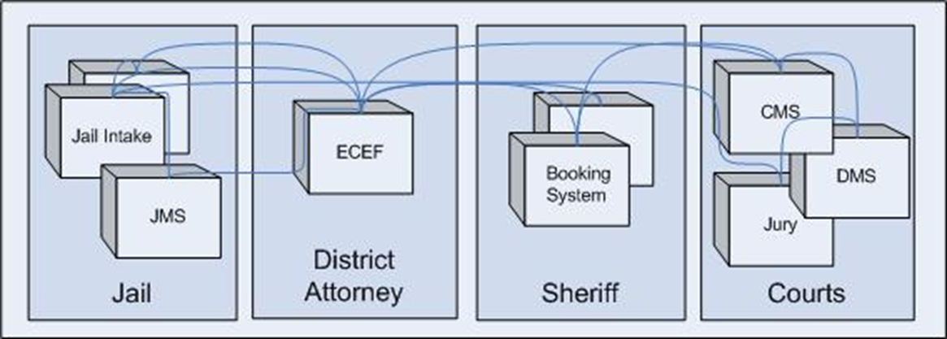
The problem…
Existing systems are mostly custom built, use custom means for integration, and exemplify stand-alone “silos” of data which make it costly and inefficient for sharing information.
Notes:
[Yogesh Chawla]

Slide 6
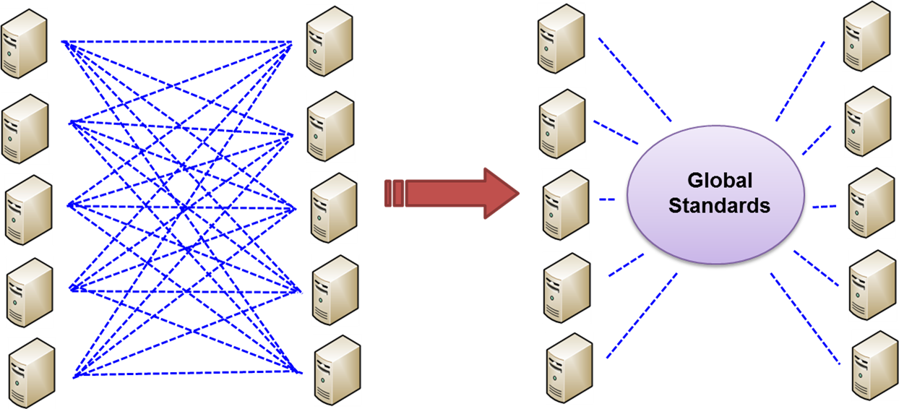
The solution…
System interface standards for Information Sharing (message, message content, security, privacy, access and privilege management)
Notes:
[Yogesh Chawla]

Slide 7
Global Justice Information Sharing Initiative (Global)
The Global Justice Information Sharing Initiative (Global) serves as a Federal Advisory Committee (FAC) and advises the U.S. Attorney General on justice information sharing and integration initiatives.
Global is a ''group of groups,'' representing more than 30 independent organizations, spanning the spectrum of law enforcement, judicial, correctional, and related bodies.
Notes:
[David Lewis/ Yogesh Chawla]

Slide 8
Global Standards Package
The Global Standards Package is a collection of normative, independently versioned standards that are assembled into a package of interoperable solutions specifically supporting the exchange of justice information.
Notes:
[David Lewis/ Yogesh Chawla]

Slide 9
Global Standards Package
Global Provides a complete information sharing solution based on Open Standards.
NIEM - The National Information Exchange Model
GRA - Global Reference Architecture
GFIPM - Global Federated Identity and Privilege Management
Privacy Policy Technical Framework
Notes:
[David Lewis/ Yogesh Chawla]

Slide 10
Global Standards Package
National Information Exchange Model (NIEM) NIEM helps to eliminate confusion associated with different data definitions across law enforcement and public organizations by providing a common vocabulary to ensure consistency and understanding among state, federal, and local agencies.
Notes:
[Yogesh Chawla/ David Lewis]

Slide 11
Global Standards Package
Global Reference Architecture (GRA) The GRA offers guidance on the design, specification, and implementation of services (e.g. Web Services) and related infrastructure
An architectural solution to sharing information through external exchanges and common messaging standards between information sharing systems.
Notes:
[Yogesh Chawla/ David Lewis]

Slide 12
Pilot: NYSIC
New York State Intelligence Center (NYSIC)
One centralized fusion center for the state of New York
Serves 570 local law enforcement agencies
Field intelligence officers in 95% of agencies
Borders Canada and tribal lands
All-crimes orientation
Merges expertise of investigators with data analysts
Utilizes two federated search tools
Access to over 25 databases (e.g., Mugshots)
Notes:
[Gloria Brewer]

Slide 13
NSECC
National Shared Execution Context Cloud (NSECC)
Serves intermediary role
Supports national-level capabilities and interstate interactions
Leverages Global Standards Package (GSP) and Global Reference Architecture (GRA)
Supports three BJA-funded projects
SORNA exchange
ICAOS/ICOTS exchange
Federated search capabilities
Notes:
[Yogesh Chawla]

Slide 14
Information Shared
Probationer | Compact Offender Address
Parolee | Address One
Offender Photo | Address Two
Compact Offender | City
First Name | State
Last Name | Zip
Middle Name | Other Residents
Offender ID | Gang Affiliation
Offender DOB | Compact Offender Information
Offender SID | Compact Case Status
FBI Number | NCIC Code(s)
Alias(es) | NCIC Description(s)
Race | Registered Sex Offender Indicator
Gender | Arrival Notice
Locations | Arrival Notice Date Transmitted
Sending State | Supervising PO Name
Receiving State | Supervising PO Email
Supervising State | Supervising PO Phone
Notes:
[Harry Hageman]

Slide 15
Limited to the Following NCIC Codes for Primary Offenses
Notes:
[Harry Hageman]

Slide 16
Global Reference Architecture Implementation
Notes:
[Yogesh Chawla]

Slide 17
Global Reference Architecture Implementation
Notes:
[Yogesh Chawla]

Slide 18
Event Reporting Entity (ICOTS)
Offender of Interest (OOI) ?
Monitor for new offender transfer
Stop
No
Yes
Yes
Send offender profile message to Intermediary Broker
Offender Profile
Note: OOI determination is based on a set of NCIC codes
Notes:
[Yogesh Chawla]

Slide 19
Intermediary Broker
Offender Transfer Notification Service
Receive offender profile message
Offender Profile
Route offender profile message based on state/zip code
Offender Profile
Notes:
[Yogesh Chawla]

Slide 20
Receiving Entity (e.g., Fusion Center)
Offender Transfer Notification Service
Offender Profile
Receive offender profile message
Acknowledgment
Forward offender profile to Agency of Interest
Review offender profile
Offender Profile
Notes:
[Yogesh Chawla/ Gloria Brewer]

Slide 21
Project Longevity
Built on existing architecture
ICOTS messages route through the NSI Shared Space Environment
No additional hardware or software required to participate
Leverages GLOBAL standards and resources
Global Reference Architecture (GRA)
National Information Exchange Model (NIEM)
Interoperable
Notes:
[David Lewis/ Adam Matz/ Yogesh Chawla/ Gloria Brewer]

Slide 22
Exchange Benefits
Intel pertinent to officer safety and awareness
Enhances police-probation/parole partnerships
Encourages communication between probation/parole and law enforcement agencies
Promotes increased probationer/parolee accountability
Encourages suppression, desistance, and supports reentry/reintegration efforts
Notes:
[David Lewis/ Adam Matz/ Yogesh Chawla/ Gloria Brewer]

Slide 23
Questions?
To get involved in the exchange please contact us to set up a meeting with the team:
Adam K. Matz, M.S.
Research Associate
American Probation and Parole Association (APPA)
Council of State Governments (CSG)
(859) 244-8058
amatz@csg.org
Notes:
[Adam Matz]
If interested, please contact me (info on the screen) and I will set up a meeting with the team to discuss the exchange and next steps.
Questions?

