Slide 1


JULY 16-22, 2023

Slide 2
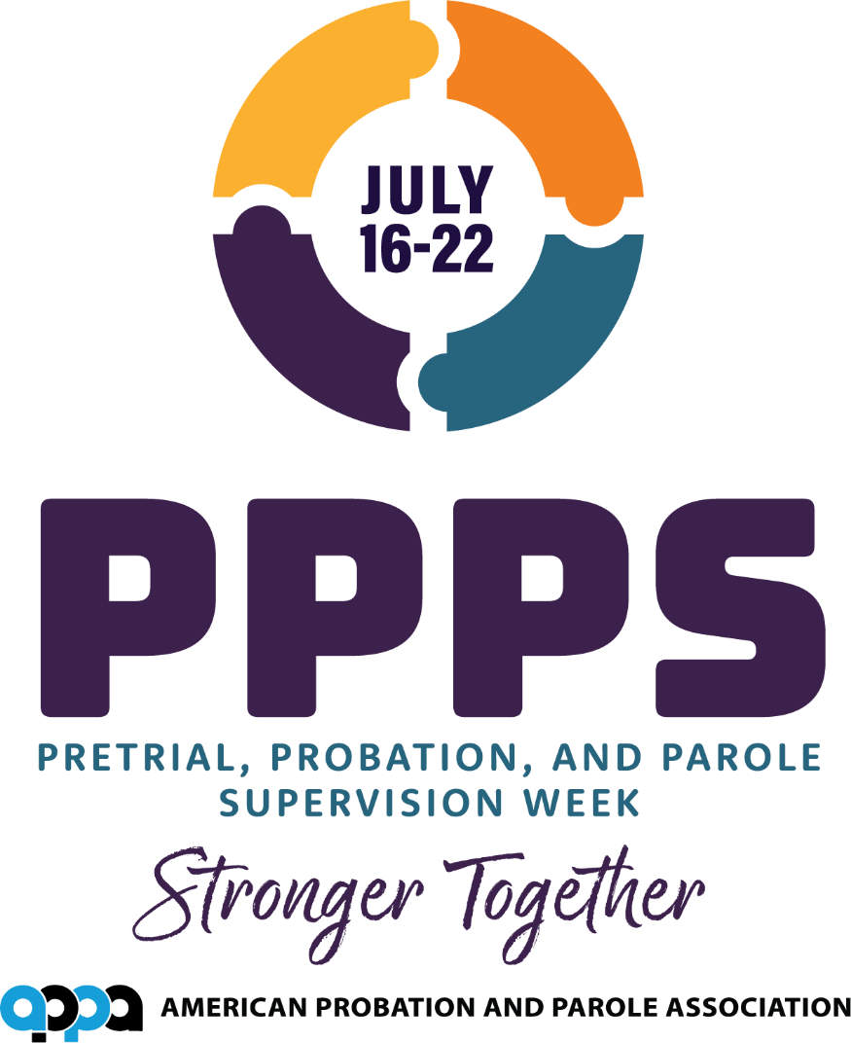

Slide 3
Pretrial, Probation,
and Parole
in the United States
Your presenter:

Slide 4
Purpose:
Define pretrial, probation, and parole
Provide information on the criminal justice process
Describe community supervision strategies
Provide national statistics
Discuss current trends in community supervision
Notes:
At this point you might give a basic overview of why you want to speak to the group you are addressing (what you know about them, who invited you…) and try to impress upon them how important the role of probation/parole is to your community.

Slide 5
What is pretrial supervision?
Pretrial programs generally perform three primary functions, (1) collect and analyze defendant information for use in determining risk, (2) to make recommendations to the court concerning conditions of release, and (3) to supervise defendants who are released from secure custody during the pretrial phase.​
Notes:
More background information on the history of probation and parole may be found on the ‘Get The Facts’ page of the APPA 2018 website: http://www.appa-net.org/PPP-Supervision-Week/get-the-facts.htm

Slide 6
Probation: an American innovation
1841 – John Augustus, the “Father of Probation”
Term derived from the Latin probare meaning a period of proving or trial
The most common form of criminal sentence or juvenile disposition in the U.S.
Notes:
More background information on the history of probation and parole may be found on the History of Probation and Parole page of the APPA 2011 Resource kit at this page:

Slide 7
Definition: Probation
A court order
Places the offender under the supervision and care of a probation officer
Often in lieu of incarceration if the probationer meets certain standards of conduct
Notes:
On this slide you could give some examples of the kinds of cases you work with and why the offender was placed on probation (or cover briefly and skip to parole if you work within the parole system).
If you work under the auspices of a court, you might explain how the judge arrives at the probation sentence or the types of offenses that generally receive probation rather than jail or prison terms.
You may describe some of the typical conditions of probation.

Slide 8
Definition: Parole
Term of conditional supervised release following a prison term
Prisoners may be released to parole either by a parole board decision or by mandatory conditional release
Parolee may be returned to prison for rule violations or other offenses
Notes:
On this slide you could give some examples of the kinds of cases you work with and how the parole system works in your state (or, for some states, explain when parole was abolished).
At this point, you could also explain some of the problems associated with re-entry into the community for offenders who have been imprisoned for many years. Employment, housing and medical care are some of the topics to discuss. More information on re-entry can be found on the statistics page of the resource kit.

Slide 9
Incarceration vs. Community Supervision
Surveyed states had an average of about $93 per inmate per day—The average annual cost of holding a person in jail was about $34,000.
In contrast, the average daily costs for managing an offender in the community in these states ranged from $3.42 per day for probationers to $7.47 per day for parolees or about $1,250 to $2,750 a year, respectively. ₁
Local Spending on Jails Tops $25 Billion in Latest Nationwide Data, Pew trust, Washington, DC, January 2021.
Notes:
Explain that community supervision is much less costly to taxpayers than incarceration, but that the most dangerous offenders will still most likely be in a prison or jail. If you supervise offenders on electronic monitoring, you could also explain the costs involved with that type of supervision (or the costs associated with any other type of specialized caseload).
Detailed state-by-state information on costs can be found in this report from the Pew Center on the States: http://www.pewcenteronthestates.org/uploadedFiles/PSPP_1in31_report_FINAL_WEB_2-27-09.pdf

Slide 10
The typical process of probation and parole
Probation
  Court hearing and finding of guilt
  Pre-sentence investigation
  Assessment
  Case planning
  Supervision
Parole
  Pre-parole investigation
  Parole hearing
  Assessment
  Case planning
  Supervision
Notes:
Describe your role in the process and perhaps how closely you work with those at other levels. Make your audience understand that PEOPLE are behind all these activities as they may not always have a good grasp of the justice process.

Slide 11
Elements of community supervision
MONITORING
INTERVENING
ADVOCACY
REFERRALS
Notes:
Details of discussion points on following pages

Slide 12
Monitoring:
Compliance with conditions of supervision
Drug testing
Electronic monitoring
Monetary obligations
Job performance
Illicit materials
Computer use
Community service
Victim safety
Notes:
Touch on the activities you are personally responsible for: do you collect urine samples? Restitution payments? Do you speak to the employers of those you supervise? Do you monitor offender community service hours?

Slide 13
Intervention
Crisis involvement
Counseling
Graduated responses
Substance abuse treatment
Job training
Relapse
Family/Social supports
Notes:
Explain how you recognize that an offender may be having problems. What do you do if you suspect an offender is once again using drugs or alcohol? Describe the resources in your community you may contact to help an offender if you feel he/she is having trouble abiding by the conditions of supervision.

Slide 14
Advocacy
Treatment
Education/Employment
Training
Budgets
Community
Notes:
Describe more about the resources available in your community. Do you have enough? Where would more funding be beneficial?

Slide 15
Referrals
Knowledge of community resources
Access to resources
Communication, coordination, and collaboration with other agencies

Slide 16
U.S. adults under
community supervision
Total (estimated) on:
Community corrections - 3,890,400
Probation - 3,053,700
Parole - 851,0001
Under the supervision of adult correctional systems at yearend 2020 – 7,795,100
Probation and Parole in the United States, 2020, US Department of Justice December 2020
Notes:
Describe the typical caseload for your agency (don’t make it sound too overwhelming even if you feel that it is!).
Describe some of the challenges in reaching the offenders you supervise. Are you in a rural or urban area? Do you make a lot of home contacts? Do you go to their workplace?

Slide 17
Trends in community supervision
Policy Reforms
Evidenced Based Practices
Reducing Revocations (for technical violations)
Evaluating Fines & Fees
Collaboration and partnerships
Results-driven management
Specialization of Caseloads
Technology
Community Engagement
Notes:
Collaboration/partnerships - Describe how you work with other agencies (courts, police, county government, health department…)
Results driven management – does your agency have set goals and how do you record them? Are you responsible for a great deal of reporting of statistics?
Rehabilitation – explain how the costs of incarceration far outweigh the costs associated with helping an offender become a productive member of the community.
Specialized caseloads – explain what specialized caseloads mean (mentally ill offenders, female offenders, drug addicted offenders…) and why they are used (special needs for special caseloads, offenders may require more of the officer’s time, offenders may require additional counseling or healthcare…)
Technology – do you supervise offenders assigned to electronic monitoring? Explain why some offenders may need such supervision.
Community justice – explain how important the COMMUNITY is to both you as the person helping the offender, but also to the offender who is making efforts to become an accepted member of the community.

Slide 18

Questions?
Notes:
Be available after your presentation for questions from your audience. Pass out brochures or handouts if you have them.

